Slide 1
Digital Logic &Design
Lecture 14

Slide 2
Recap
Odd-Prime Number Detector Circuit
  Using Quine-McCluskey Method
Combinational Logic
Implemented in SOP and POS form
Design and Implementation Steps
Timing Diagram
Active High/Low inputs/outputs

Slide 3
Odd-Parity Function
Input |  |  |  | Output | Input |  |  |  | Output
D₃ | D₂ | D₁ | D₀ | P | D₃ | D₂ | D₁ | D₀ | P
0 | 0 | 0 | 0 | 1 | 1 | 0 | 0 | 0 | 0
0 | 0 | 0 | 1 | 0 | 1 | 0 | 0 | 1 | 1
0 | 0 | 1 | 0 | 0 | 1 | 0 | 1 | 0 | 1
0 | 0 | 1 | 1 | 1 | 1 | 0 | 1 | 1 | 0
0 | 1 | 0 | 0 | 0 | 1 | 1 | 0 | 0 | 1
0 | 1 | 0 | 1 | 1 | 1 | 1 | 0 | 1 | 0
0 | 1 | 1 | 0 | 1 | 1 | 1 | 1 | 0 | 0
0 | 1 | 1 | 1 | 0 | 1 | 1 | 1 | 1 | 1
Notes:
The function table represents the 16 possible combination of 4 data bits
The 4 data bits are represented by variables D3, D2, D1 and D0
The output P represents the state of the Parity bit.
Since Odd parity is being used therefore the 4-bit data and the parity bit should add up to give odd number of 1s.
The function table shows the Parity bit set to 1 when the 16, 4-bit data input combinations have no 1s or an even number of 1s.

Slide 4
SOP Expression SImplification
D₃D₂\D₁D₀ | 00 | 01 | 11 | 10
00 | 1 | 0 | 1 | 0
01 | 0 | 1 | 0 | 1
11 | 1 | 0 | 1 | 0
10 | 0 | 1 | 0 | 1
Notes:
The information in the function table is mapped directly to a four variable K-map to simplify the Boolean expression represented by the Odd-parity generator function.
None of the 1s mapped in the K-map are adjacent to each other thus the function mapped to the K-map can not be simplified.
However, using the Rules of Boolean algebra, applying Demorgan’s theorems and knowing the function table of XOR and XNOR gates the Boolean expression can be simplified

Slide 5
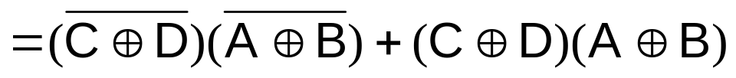
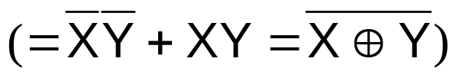
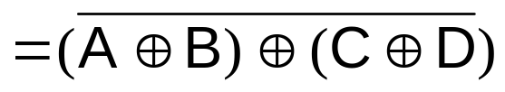
Simplifying Expression
Notes:
The expression has 8 minterms
The expression for the sake of simplification is represented in terms of variables A, B, C and D instead of D3, D2, D1 and D0 respectively.
The expression can be rewritten in terms of the common product terms A*B*, A*B, AB and AB* and sum of product terms C*D*+CD and C*D+CD*
The expression can be further represented in terms of sum of product terms C*D*+CD, A*B*+AB, C*D+CD* and A*B+AB*
The four sum of product terms represent C XNOR D, A XNOR B, C XOR D and A XOR B
The expression if seen in terms of X and Y simplifies to A XOR B XNORed with C XOR D

Slide 6
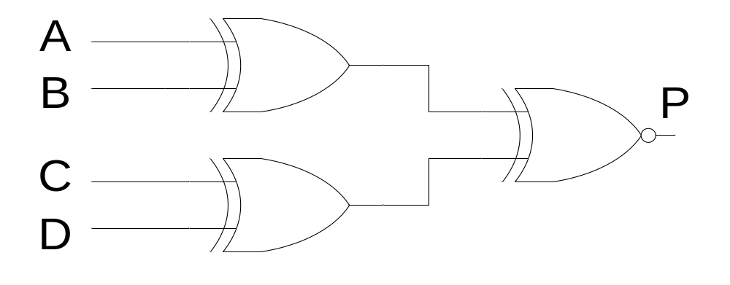
Odd-Parity Generator Circuit
Notes:
Thus the original 8 minterm expression is implemented using 2 XOR and a single XNOR gate

Slide 7
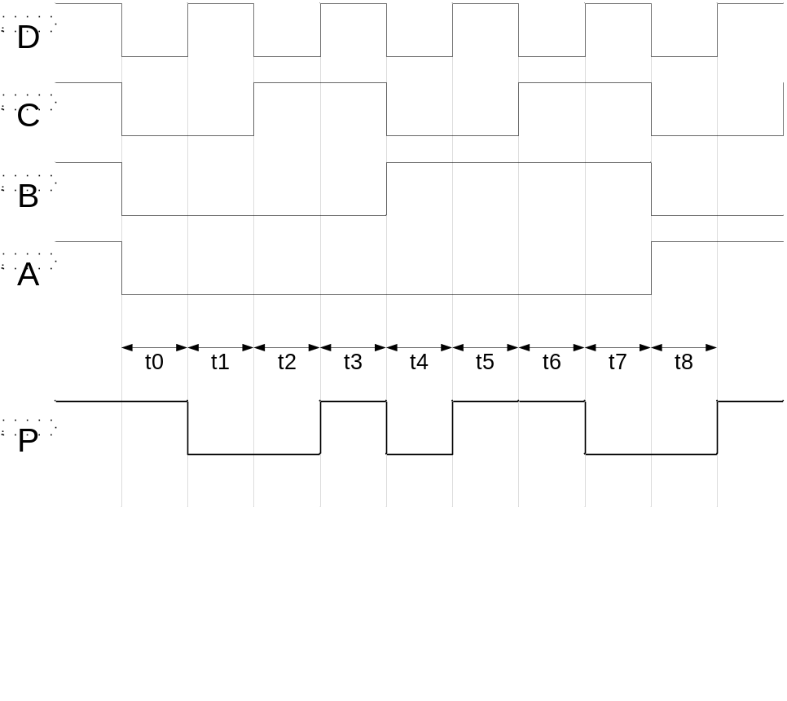
Operation of Odd-Parity circuit
Notes:
The timing diagram shows the operation of the Odd-Parity generator circuit.
The A, B, C and D timing diagrams represent the changing 4-bit data values.
During time interval t0 the 4-bit data value is 0000, during time interval t1, the data value changes to 0001.
Similarly during time intervals t2, t3, t4 up to t8 the data values change to 0010, 0011, 0100 and 1000 respectively.
During interval t0 the output of the two XOR gates is 00, therefore the output of the XNOR gate is 1.
At interval t1, the outputs of the two XOR gates is 10, therefore the output of the XNOR gate is 0.
The output P can similarly be traced for intervals t2 to t8

Slide 8
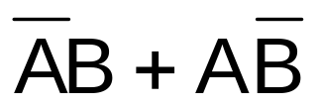
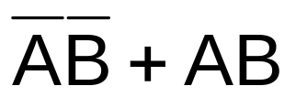
XOR & XNOR Gates
XOR function
XNOR function

Slide 9
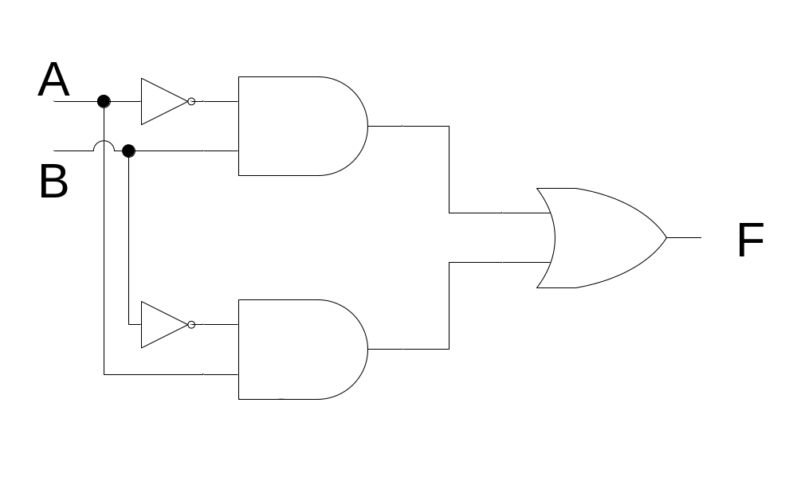
XOR Gate
Notes:
The XOR operation performs a comparison function.
An XOR operation detects dissimilar inputs.
The XOR gate can be implemented using a combination of NOT-AND-OR gates.
Since the function performed by the XOR gate is commonly used in digital circuits therefore XOR gates are available in Integrated circuit form which can be readily used instead of implementing a XOR circuit based on NOT-AND-OR combination of gates.

Slide 10
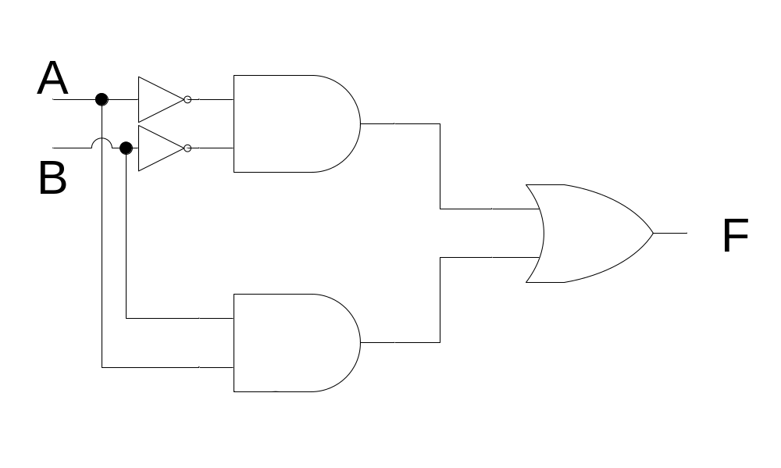
XNOR Gate
Notes:
The XNOR operation performs a comparison function.
An XNOR operation detects similar inputs.
The XNOR gate can also be implemented using a combination of NOT-AND-OR gates.
Since the function performed by the XNOR gate is commonly used in digital circuits therefore XNOR gates are available in Integrated circuit form which can be readily used instead of implementing a XNOR circuit based on NOT-AND-OR combination of gates.

Slide 11
Combinational Functional Devices
Comparators
BCD to 7-Segment
Parity Generator Circuit

Slide 12
Half & Full Adders
Half Adder
Full Adder

Slide 13
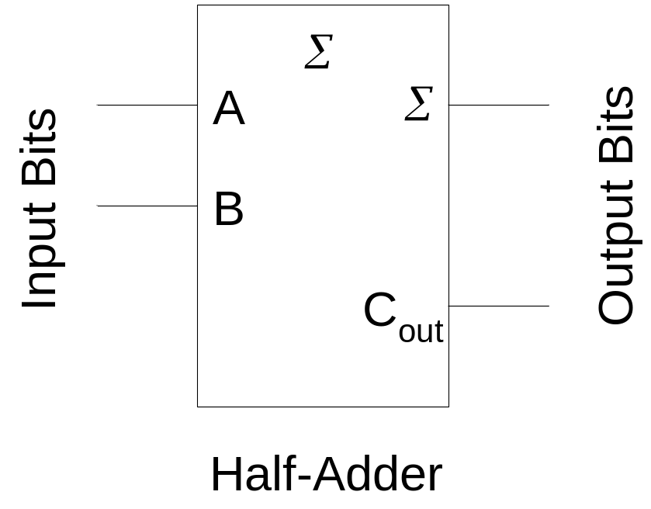
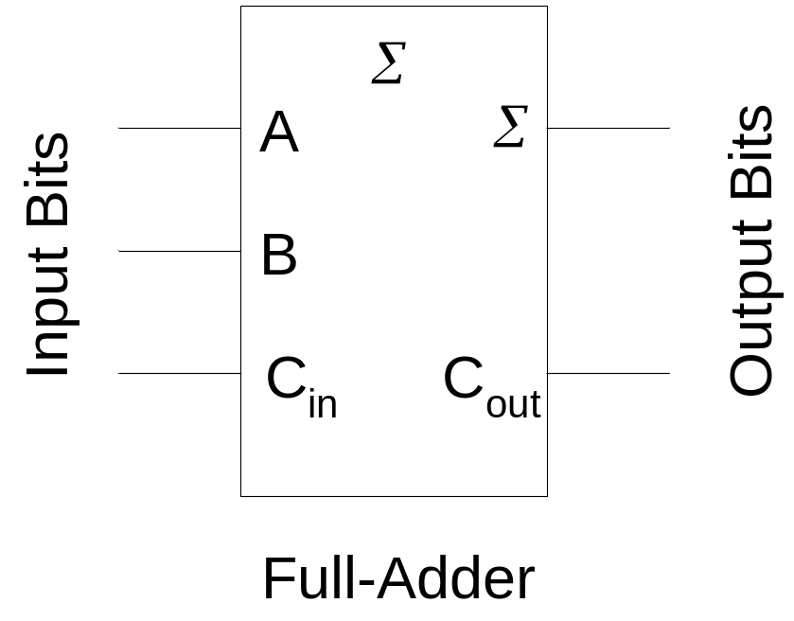
Half & Full Adders
Notes:
The block diagrams represent a Full-Adder and a Half-Adder.
A single bit binary adder circuit basically adds two bits and a carry bit, generated by the addition of the least significant bits. The output of the single bit adder circuit generates a sum bit and a carry bit.
An adder circuit that only has two bit input representing the two single bit numbers A and B and does not have the carry bit input from the least significant digit is regarded as a half-adder.
An adder circuit that has three inputs, two bits representing the two single bit numbers A and B, and the third bit represents the Carry in bit is regarded as a full-adder

Slide 14
Half-Adder
Function Table
Expression
Logic Circuit

Slide 15
Half-Adder Function Table
Input |  | Output
A | B | Sum | Carry Out
0 | 0 | 0 | 0
0 | 1 | 1 | 0
1 | 0 | 1 | 0
1 | 1 | 0 | 1

Slide 16


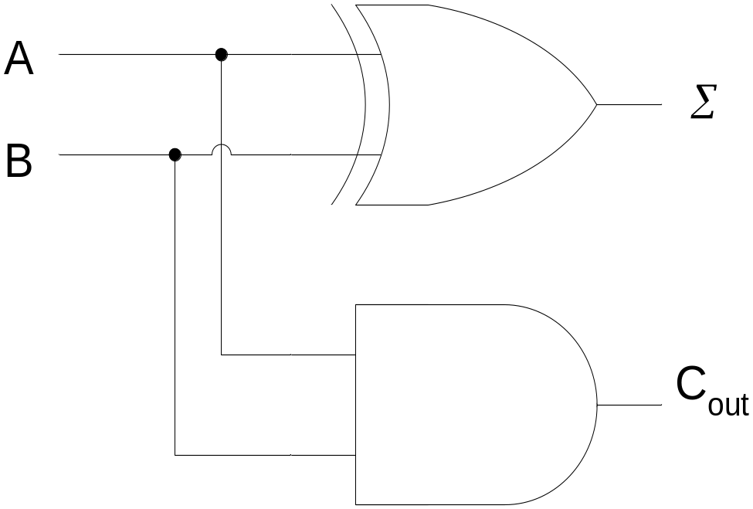
Half-Adder Circuit

Slide 17
Full-Adder
Function Table
Expression
Logic Circuit

Slide 18
Full-Adder Function Table
Input |  |  | Output
A | B | Carry In (C) | Sum | Carry Out
0 | 0 | 0 | 0 | 0
0 | 0 | 1 | 1 | 0
0 | 1 | 0 | 1 | 0
0 | 1 | 1 | 0 | 1
1 | 0 | 0 | 1 | 0
1 | 0 | 1 | 0 | 1
1 | 1 | 0 | 0 | 1
1 | 1 | 1 | 1 | 1

Slide 19

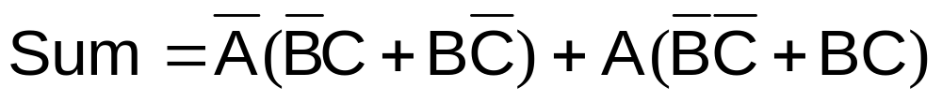
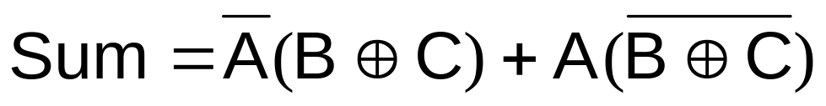

Sum Expression

Slide 20

Carry Out Expression

Slide 21
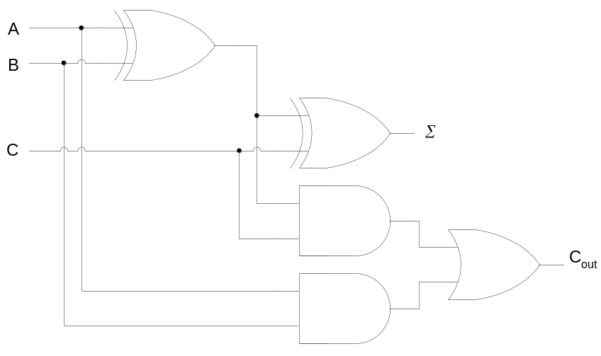
Full-Adder Circuit

Slide 22
Full-Adder
Full-Adder = Half-Adder + Half-Adder

Slide 23
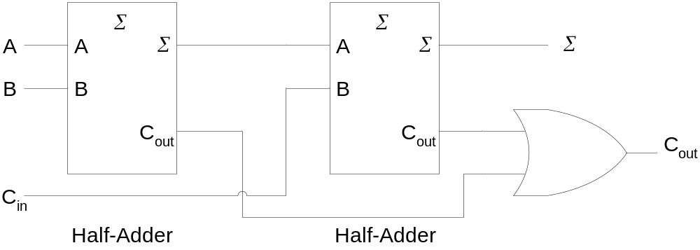
Full-Adder based on
Two Half-Adders

Slide 24
Parallel Binary Adder
Multiple Single bit Full-Adder connected in Parallel

Slide 25
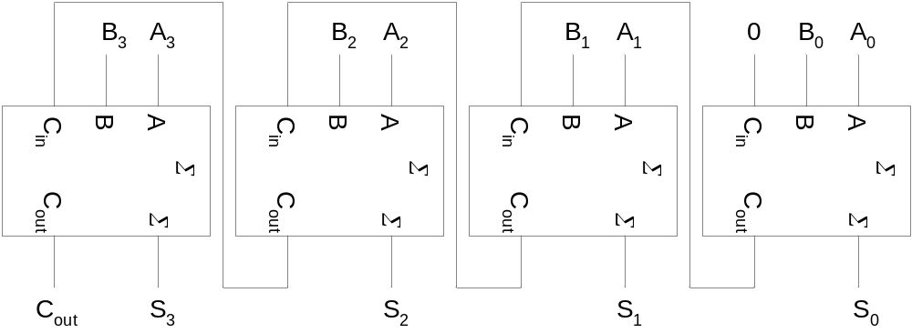
4-bit Parallel Adder

Slide 26
Carry Propagation
Carry Ripple
Look-Ahead Carry Circuits

Slide 27
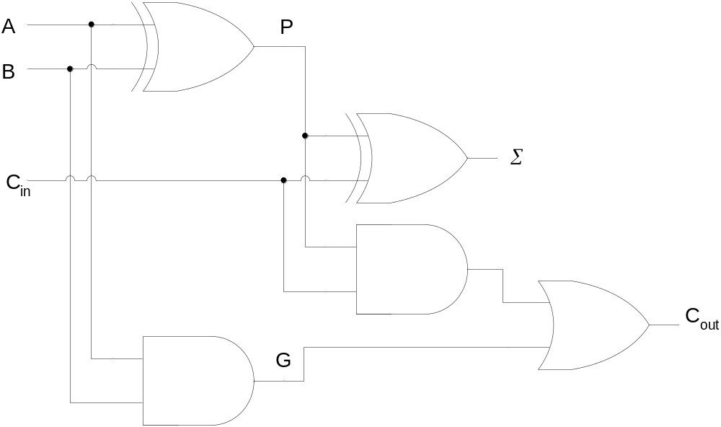
Look-Ahead Carry Circuit
Notes:
The P output is called the Carry Propagate.
The G output is called the Carry Generate as it generates a carry when A and B are both 1 regardless of C in.

Slide 28

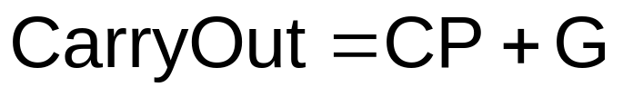
Sum & Carry Expressions

Slide 29
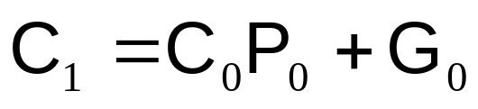
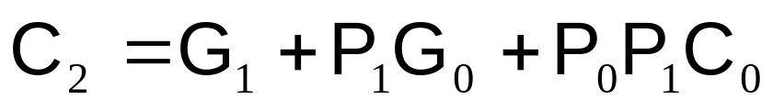
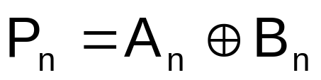
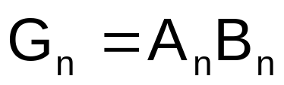
Carry Expressions

Slide 30
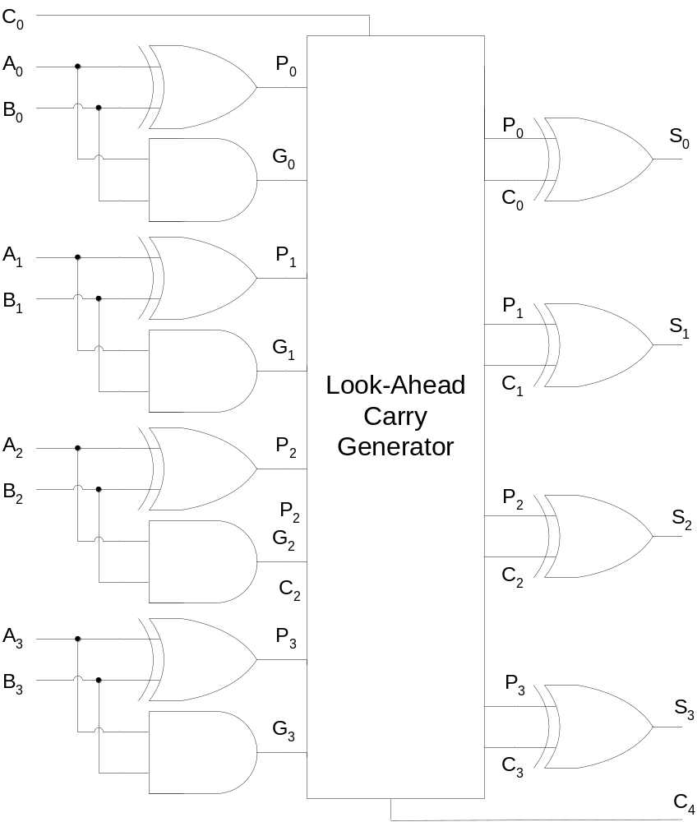
Look-Ahead Carry Generator

Slide 31
MSI-Adders
74LS83A
74LS283
16-pin ICs
4-bit A input
4-bit B input
4-bit Sum output
1-bit Carry in
1-bit Carry Out

Slide 32
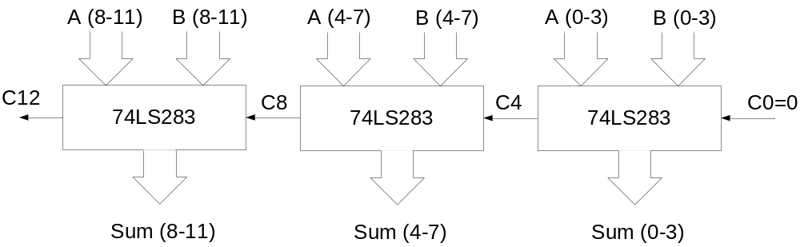
12-bit Parallel Adder
Notes:
The first 4-bit Adder chip on the extreme right is used to add bits 0 to 3, the least significant four bits of the two 12 bit numbers.
The second 4-bit Adder chip in the middle is used to add bits 4 to 7, the next most significant bits of the two 12 bit numbers.
Finally, the third 4-bit Adder chip on the extreme left is used to add the most significant bits 8 to 11 of the 12-bit numbers.
Similarly the 4-bit adder chip on the extreme right generates least significant Sum outputs 0 to 3.
The second 4-bit Adder chip generates Sum output for bits 4 to 7.
The third 4-bit Adder chip on the extreme left generates the Sum outputs for most significant bits 8 to 11.
The Carry out is generated by the left most 4-bit Adder. It is shown as C12
Similarly the Carry in is shown connected to the right most 4-bit adder. It is represented by C0.
Carry out of the first 4-bit Adder on the extreme right is connected to the Carry In of the 4-bit adder in the middle. It is represented as C4.
The Carry out of the middle 4-bit adder is connected to the Carry in of the 4-bit Adder on the extreme left. It is represented by C8.

